Slide 1
Quick introduction to
GitHub Desktop
Laura Manuel
Software Engineer
Clinical Informatics Research Division

Slide 2
Getting Started
Install github desktop
https://help.github.com/desktop/guides/getting-started/setting-up-github-desktop/

Slide 3
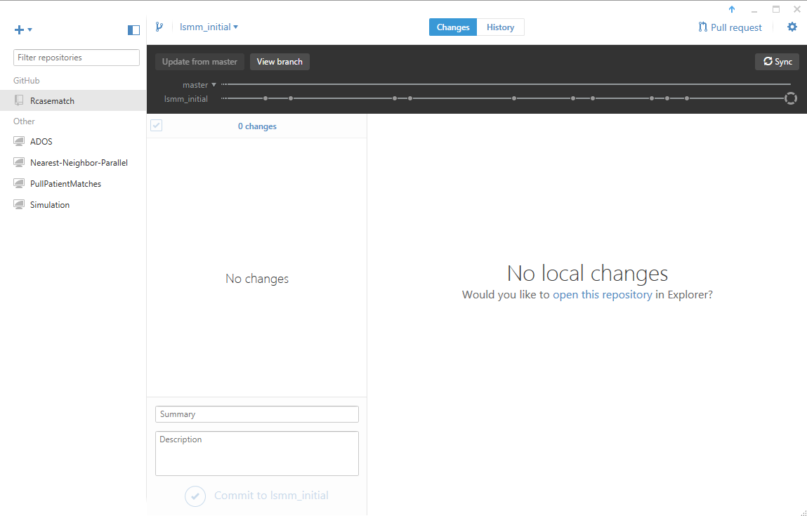
Create new branch
Current Branch
View Uncommited Changes
View Change History
Add Repository
Filter
Sync with Github
Github Repositories
Files with changes to commit
Local Repositories

Slide 4
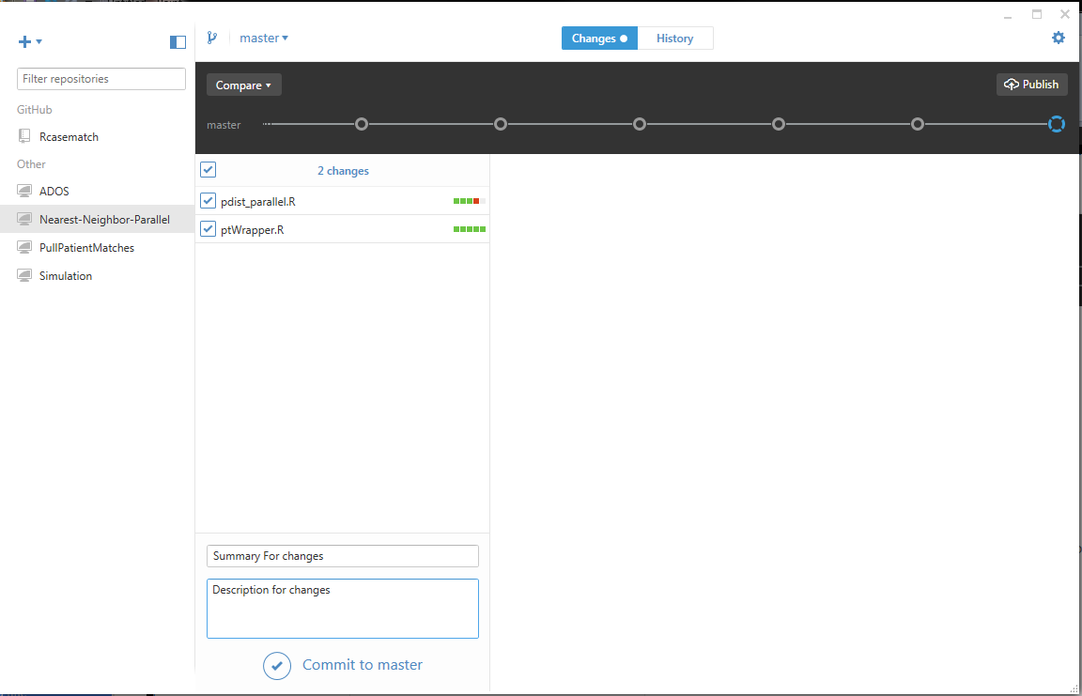
Commit to current branch
Select the repository you wish to commit to.
Select the “Changes” tab. There will be a circle if there are uncommitted changes.
Check the files you wish to commit (note: You can add file types to your gitIgnore list to stop them from appearing on this list)
Add a summary and description
Click “Commit to XXX”
For repositories hosted on github don’t forget to press “Sync”

Slide 5
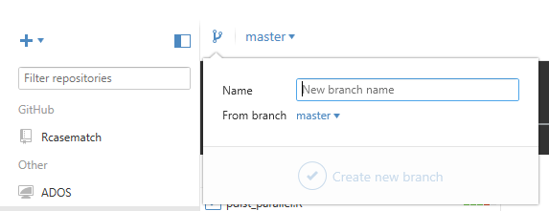
Branch
1- Select the repository you wish to branch.
2- Commit any uncommitted changes.
3- Click the “Create New Branch” icon
4- Enter a name for your branch
5- Select the branch to “branch” from.
6- Click “Create New Branch”. You will automatically be working in that branch.

Slide 6
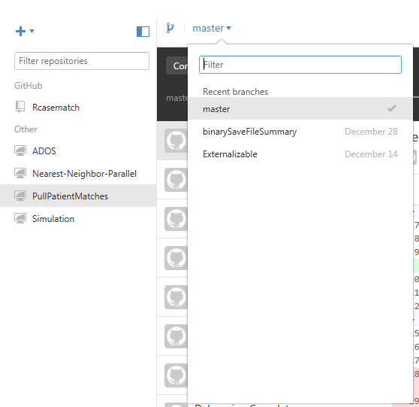
Switch Branches
1- Select the repository you wish to use.
2- Commit any uncommitted changes.
3- Select the new branch from the drop down.

Slide 7
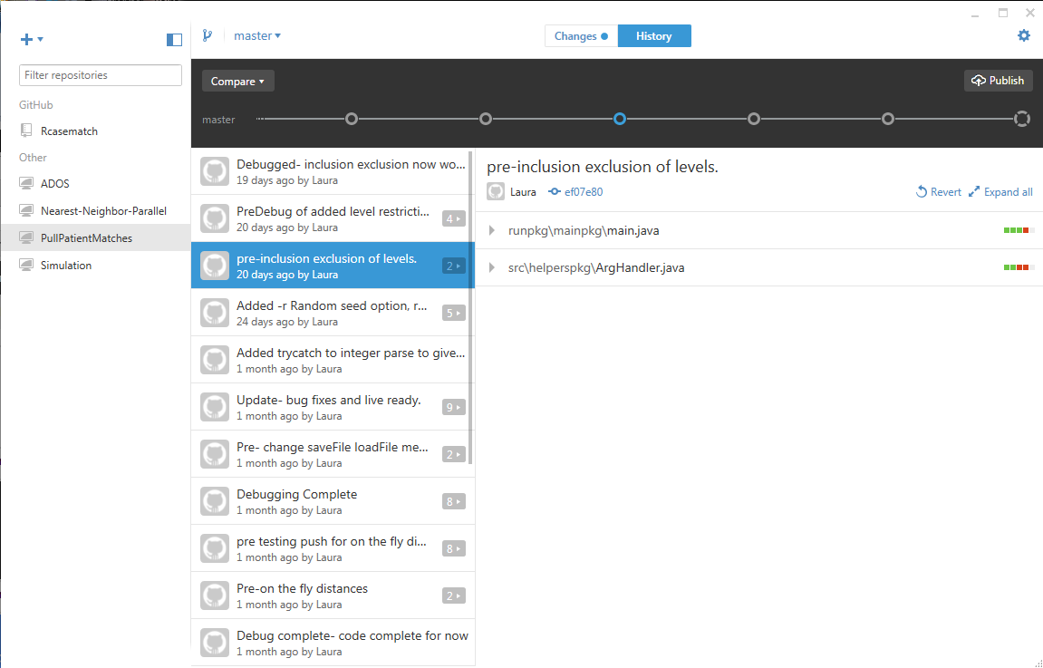
Revert to a previous commit
1- Select the repository you wish to use.
2- Commit any uncommitted changes.
3- Select the previous commit you wish to use
4- Click “Revert”

Slide 8
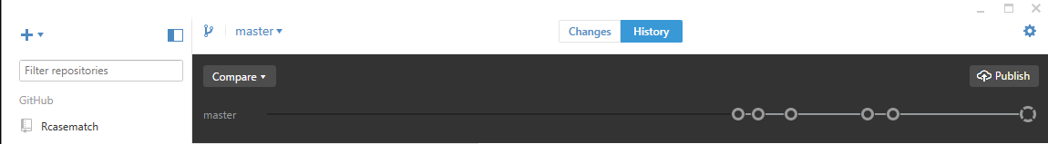
Merge
1- Select the repository you wish to use.
2- Commit any uncommitted changes to your current branch
3- Select the branch you wish to merge into (update).
4- Select “Compare”
(continued on next slide)

Slide 9
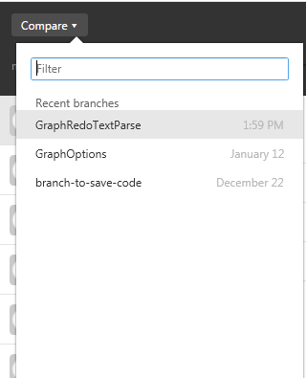
Merge (2)
5- Select the branch you wish to pull changes from
(continued on next slide)

Slide 10
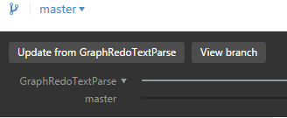
Merge (3)
6- Select “Update From XXX”

Slide 11
Merge (4)
7- Handle any merge conflicts… (No merge conflicts in any of mine, heh)
8- Click “Sync” if your repository is hosted on github

